Slide 1
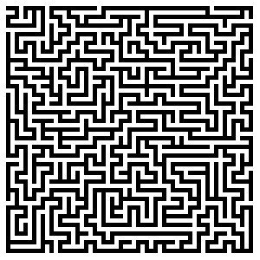


CS 5/7320 Artificial Intelligence Solving problems by searching AIMA Chapter 3
Slides by Michael Hahsler based on slides by Svetlana Lazepnik with figures from the AIMA textbook.
This work is licensed under a Creative Commons Attribution-ShareAlike 4.0 International License.
Online Material

Slide 2
Contents
What are search problems?
Tree search
Uninformed search
Informed search
Search space

Slide 3
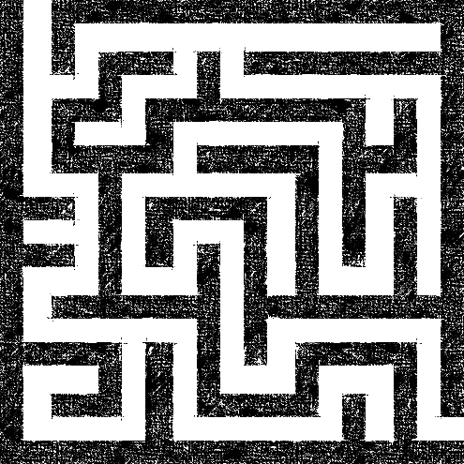
What are Search Problems?
We will consider the problem of designing goal-based agents in known, fully observable, and deterministic environments.
Example environment:
Start
Exit

Slide 4
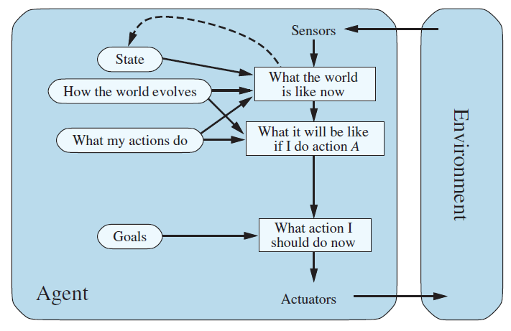
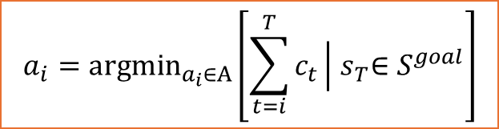
Remember: Goal-based Agent
The agent has the task to reach a defined goal state.
The performance measure is typically the cost to reach the goal.
We will discuss a special type of goal-based agents called planning agents which use search algorithms to plan a sequence of actions that lead to the goal.
Agent’s location
Maze
Map of the maze
Search for a plan
Exit location
$$a_{i}={argmin}_{a_{i}∈A}\left[\sum_{t=i}^{T}{c_{t}}\left|{ s}_{T}∈S^{goal}\right.\right]$$

Slide 5
Planning for Search Problems
For now, we consider only a discrete environment using an atomic state representation (states are just labeled 1, 2, 3, …).
The state space is the set of all possible states of the environment and some states are marked as goal states.
The optimal solution is the sequence of actions (or equivalently a sequence of states) that gives the lowest path cost for reaching the goal.
Initial state
1
Goal state
z
Phases:
Search/Planning: the process of looking for the sequence of actions that reaches a goal state. Requires that the agent knows what happens when it moves!
Execution: Once the agent begins executing the search solution in a deterministic, known environment, it can ignore its percepts (open-loop system).

Slide 6
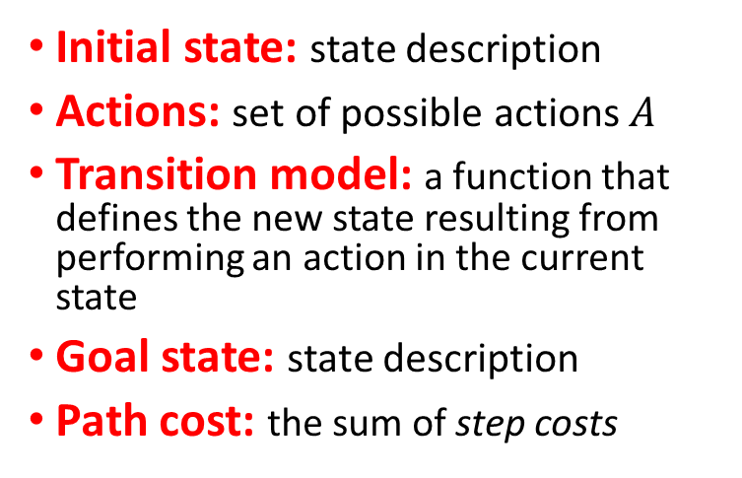
Definition of a Search Problem
Initial state
Actions: {N, E, S, W}
Transitions
Initial state: state description
Actions: set of possible actions $A$
Transition model: a function that defines the new state resulting from performing an action in the current state
Goal state: state description
Path cost: the sum of step costs
1
g
i
4
a
Goal state
z
Discretization grid
Important: The state space is typically too large to be enumerated, or it is continuous. Therefore, the problem is defined by initial state, actions and the transition model and not the set of all possible states.

Slide 7
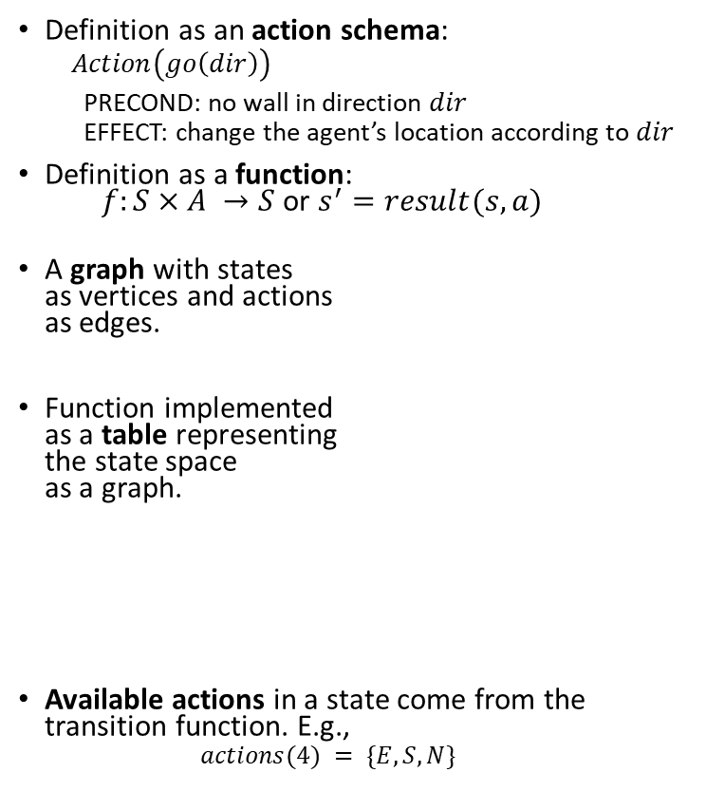
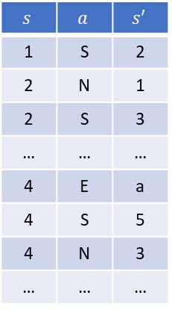
Transition Function and Available Actions
Definition as an action schema:
$$Action\left(go\left(dir\right)\right)$$ PRECOND: no wall in direction $dir$ EFFECT: change the agent’s location according to $dir$
Definition as a function: $f:S×A →S$or $s^{′}=result(s, a)$
A graph with states as vertices and actions as edges.
Function implemented as a table representing the state space as a graph.
Available actions in a state come from the transition function. E.g.,
$$actions(4) = \{E, S, N\}$$
Original Description
Initial state
Actions: {N, E, S, W}
Transitions
1
g
$$s$$ | $$a$$ | $$s′$$
1 | S | 2
2 | N | 1
2 | S | 3
… | … | …
4 | E | a
4 | S | 5
4 | N | 3
… | … | …
2
i
3
4
a
5
z
Discretization grid
Goal state
Note: Known and deterministic is a property of the transition function!

Slide 8


Example: Romania Vacation
Original Description
On vacation in Romania; currently in Arad
Flight leaves tomorrow from Bucharest
Initial state: Arad
Actions: Drive from one city to another.
Transition model and states: If you go from city A to city B, you end up in city B.
Goal state: Bucharest
Path cost: Sum of edge costs.
State Space/Transition model
Defined as a graph
Distance in miles

Slide 9

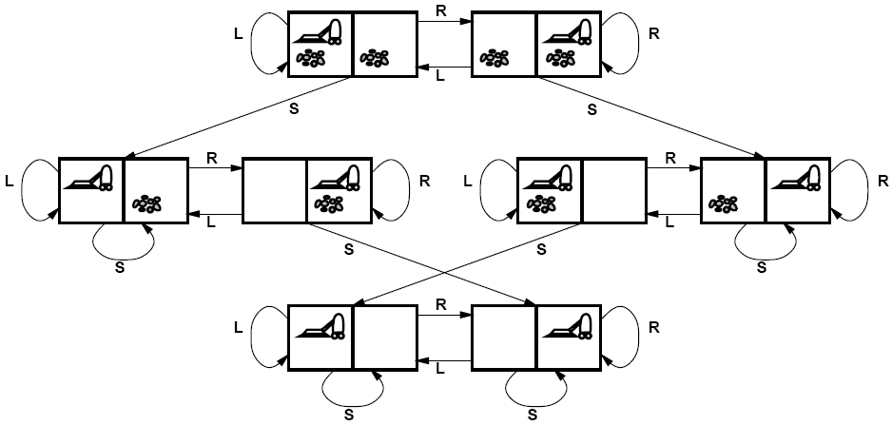
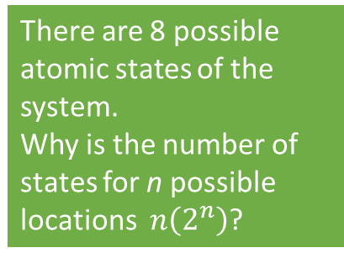
Example: Vacuum world
State Space
Goal states
Initial State: Defined by agent location and dirt location.
Actions: Left, right, suck
Transition model: Clean a location or move.
Goal state: All locations are clean.
Path cost: E.g., number if actions
There are 8 possible atomic states of the system.
Why is the number of states for n possible locations $n\left(2^{n}\right)$?

Slide 10

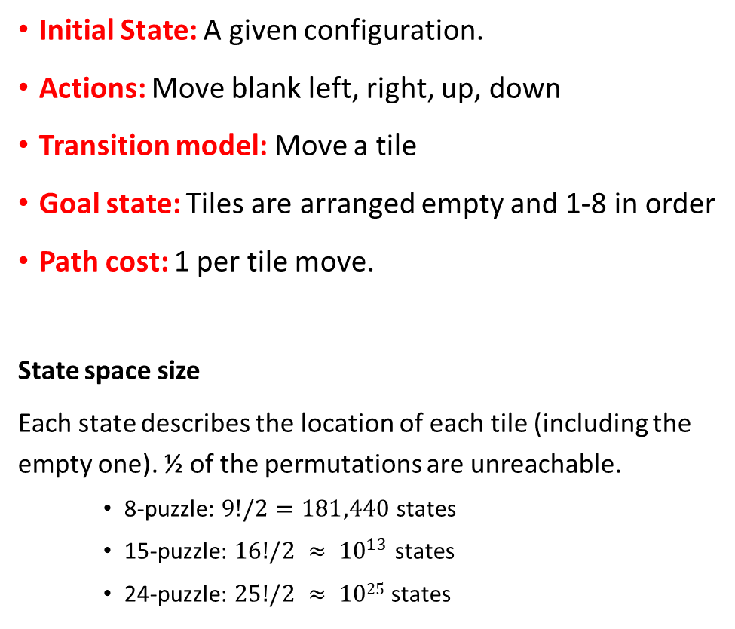
Example: Sliding-tile Puzzle
Initial State: A given configuration.
Actions: Move blank left, right, up, down
Transition model: Move a tile
Goal state: Tiles are arranged empty and 1-8 in order
Path cost: 1 per tile move.
State space size
Each state describes the location of each tile (including the empty one). ½ of the permutations are unreachable.
8-puzzle: $9!/2=181,440$states
15-puzzle: $16!/2 ≈ {10}^{13}$ states
24-puzzle: $25!/2 ≈ 1025$states

Slide 11
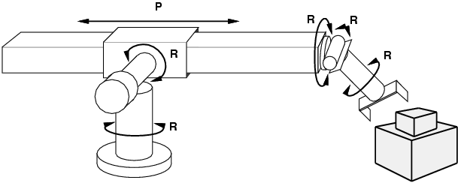
Example: Robot Motion Planning
Initial State: Current arm position with real-valued coordinates of robot joint angles.
Actions: Continuous motions of robot joints.
Transition model: Movement.
Goal state: Desired final configuration (e.g., object is grasped).
Path cost: Time to execute, smoothness of path, etc.

Slide 12

Tree Search

Slide 13
Solving Search Problems
Given a search problem definition
Initial state
Actions
Transition model
Goal state
Path cost
How do we find the optimal solution (sequence of actions/states)?
Construct a search tree for the state space graph!
Initial state
State space
Goal states

Slide 14
Issue: Transition Model is a Graph and Not a Tree!
Cycles
Return to the same state
Initial state
Non-cycle redundant paths
Multiple paths to get to the same state
Goal states
Initial state
Path 1
Path 2
Goal states

Slide 15
Creating a Search Tree
Superimpose a “what if” tree of possible actions and outcomes (states) on the state space graph.
The Root node represents the initial stare.
An action child node is reached by an edge representing an action. The corresponding state is defined by the transition model.
Trees cannot have cycles (loops). Cycles in the search space must be broken to prevent infinite loops.
Trees cannot have multiple paths to the same state. These are called redundant paths. Removing other redundant paths improves search efficiency.
A path through the tree corresponds to a sequence of actions (states).
A solution is a path ending in a node representing a goal state.
Nodes vs. states: Each tree node represents a state of the system. If redundant path cannot be prevented then state can be represented by multiple nodes in the tree.
Root node = Initial state
a
Edge = Action
Child node
Non-cycle redundant
path
b
c
d
e
e
Cycle
…
…
…
b
Solution path
Node representing a Goal state
f

Slide 16
Differences Between Typical Tree Search and AI Search
Typical tree search
Assumes a given tree that fits in memory.
Trees have by construction no cycles or redundant paths.
AI tree/graph search
The search tree is too large to fit into memory.
Builds parts of the tree from the initial state using the transition function representing the graph.
Memory management is very important.
The search space is typically a very large and complicated graph. Memory-efficient cycle checking is very important to avoid infinite loops or minimize searching parts of the search space multiple times.
Checking redundant paths often requires too much memory and we accept searching the same part multiple times.

Slide 17
Tree Search Algorithm Outline
Initialize the frontier (set of unexplored known nodes) using the starting state/root node.
While the frontier is not empty:
Choose the next frontier node to expand according to the search strategy.
If the node represents a goal state, return it as the solution.
Else expand the node (i.e., apply all possible actions to the transition model) and add its children nodes representing the newly reached states to the frontier.

Slide 18
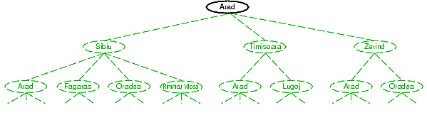
Tree Search Example
Frontier
Transition model

Slide 19
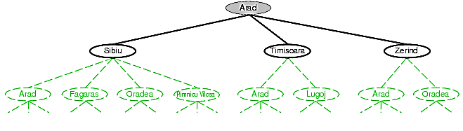
Tree Search Example
1. Expand Arad
Frontier
Transition model

Slide 20
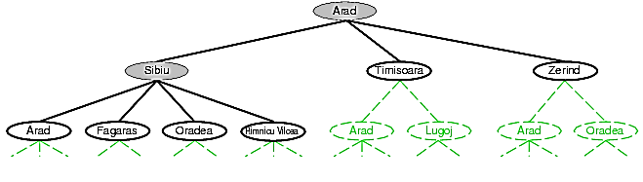
Tree Search Example
Frontier
2. Expand Sibiu
Transition model
Example of a cycle
We could have also expanded Timisoara or Zerind!

Slide 21
Search Strategies: Properties
A search strategy is defined by picking the order of node expansion.
Strategies are evaluated along the following dimensions:
Completeness: does it always find a solution if one exists?
Optimality: does it always find a least-cost solution?
Time complexity: how long does it take?
Space complexity: how much memory does it need?
We will discuss different search strategies and use these properties to compare them.

Slide 22
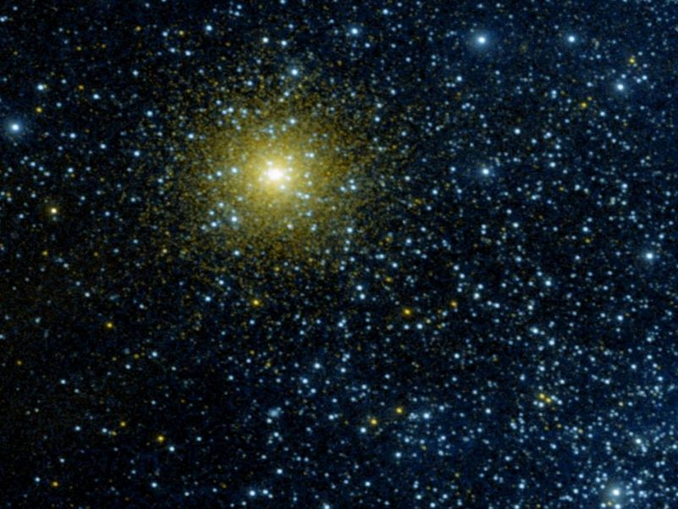
Space and Time Complexity State Space vs. Search Tree Size

Slide 23
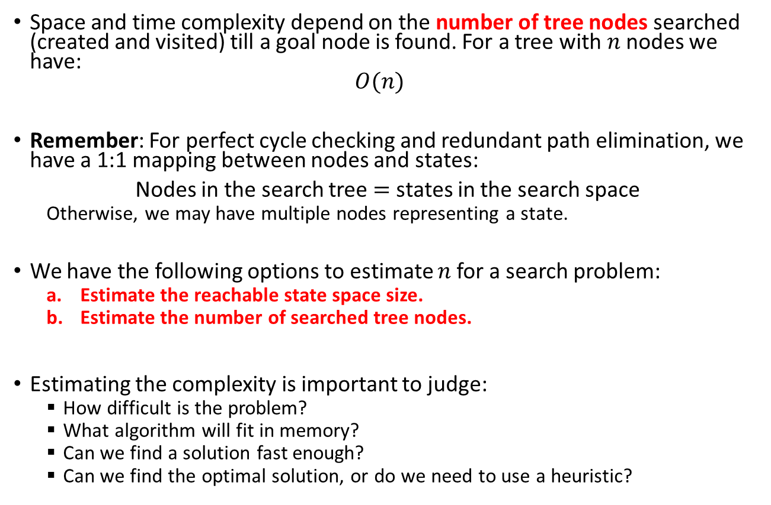
State Space vs. Search Tree Size
Space and time complexity depend on the number of tree nodes searched (created and visited) till a goal node is found. For a tree with $n$ nodes we have: $O(n)$
Remember: For perfect cycle checking and redundant path elimination, we have a 1:1 mapping between nodes and states:
Nodes in the search tree $=$ states in the search space
Otherwise, we may have multiple nodes representing a state.
We have the following options to estimate $n$ for a search problem:
Estimate the reachable state space size.
Estimate the number of searched tree nodes.
Estimating the complexity is important to judge:
How difficult is the problem?
What algorithm will fit in memory?
Can we find a solution fast enough?
Can we find the optimal solution, or do we need to use a heuristic?

Slide 24
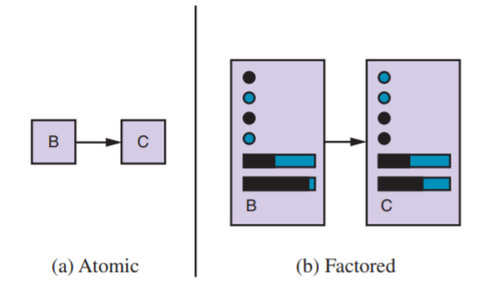
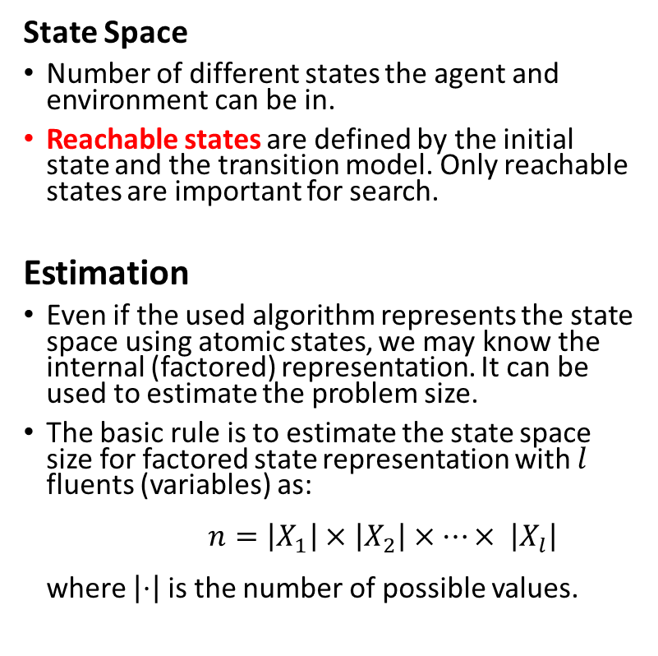
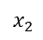
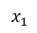
State Space Size Estimation
State Space
Number of different states the agent and environment can be in.
Reachable states are defined by the initial state and the transition model. Only reachable states are important for search.
Estimation
Even if the used algorithm represents the state space using atomic states, we may know the internal (factored) representation. It can be used to estimate the problem size.
The basic rule is to estimate the state space size for factored state representation with $l$ fluents (variables) as: $n=\left|X_{1}\right|×\left|X_{2}\right|×⋯× \left|X_{l}\right|$ where $\left|⋅\right|$ is the number of possible values.
State representation
$$x_{1}$$
$$x_{2}$$
…
The factored state consists of variables called fluents that represent conditions that can change over time.

Slide 25
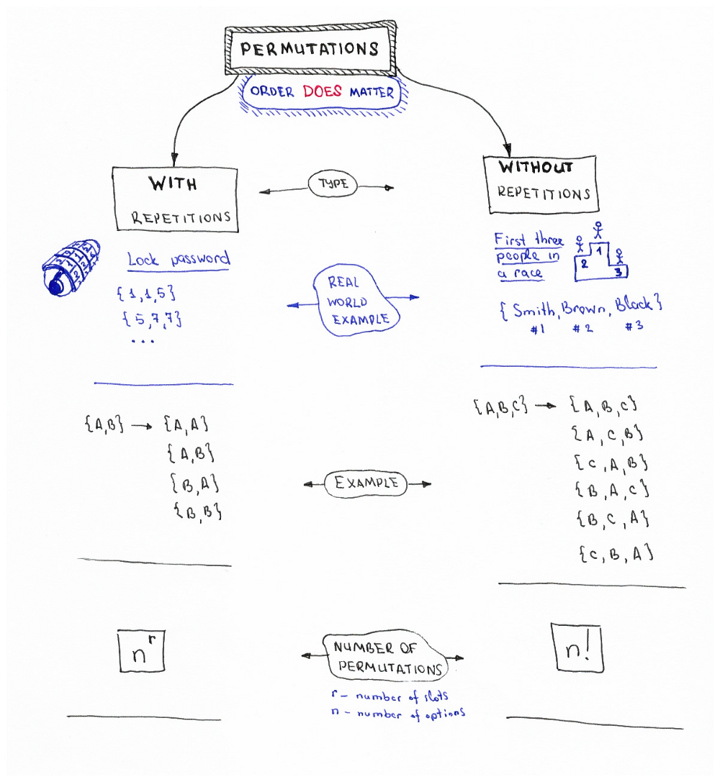

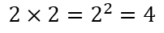
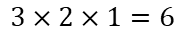
Reminder: Combinatorics - Permutations
In how many ways can we order/arrange n objects?
$$2×2=2^{2}=4$$
$$3×2×1=6$$
Factorial: $n!=n×\left(n−1\right)×…×2×1$
# Python
import math
math.factorial(23)
Source: Permutations/Combinations Cheat Sheets by Oleksii Trekhleb https://itnext.io/permutations-combinations-algorithms-cheat-sheet-68c14879aba5

Slide 26
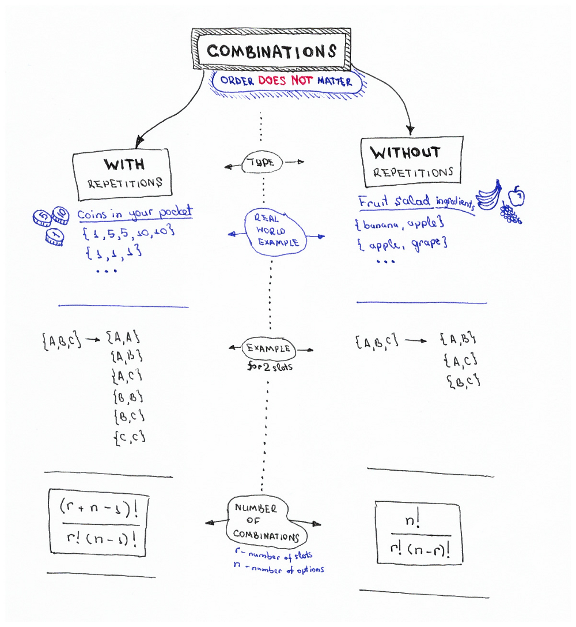
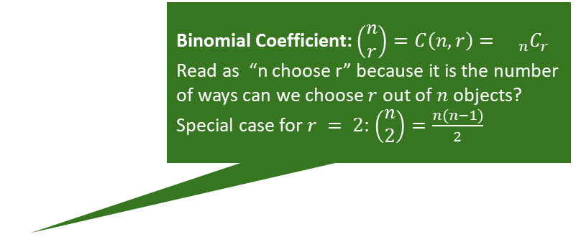
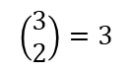
Reminder: Combinatorics - Combinations
Binomial Coefficient: $\left(\begin{matrix}n \\ r\end{matrix}\right)=C\left(n,r\right)={{}_{n}C}_{r}$
Read as “n choose r” because it is the number of ways can we choose $r$ out of $n$ objects?
Special case for $r = 2$: $\left(\begin{matrix}n \\ 2\end{matrix}\right)=\frac{n(n−1)}{2}$
$$\left(\begin{matrix}3 \\ 2\end{matrix}\right)=3$$
# Python
import scipy.special
# the two give the same results
scipy.special.binom(10, 5)
scipy.special.comb(10, 5)
Source: Permutations/Combinations Cheat Sheets by Oleksii Trekhleb https://itnext.io/permutations-combinations-algorithms-cheat-sheet-68c14879aba5

Slide 27
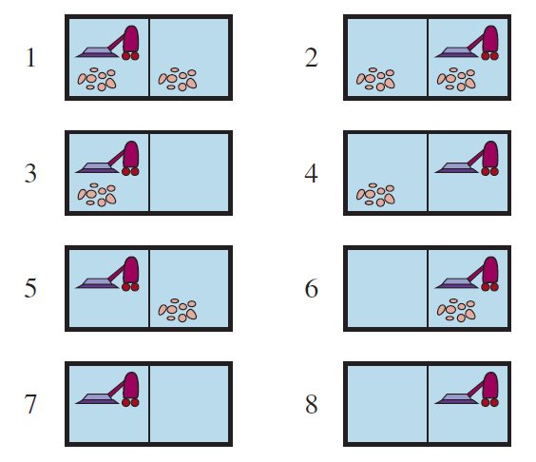
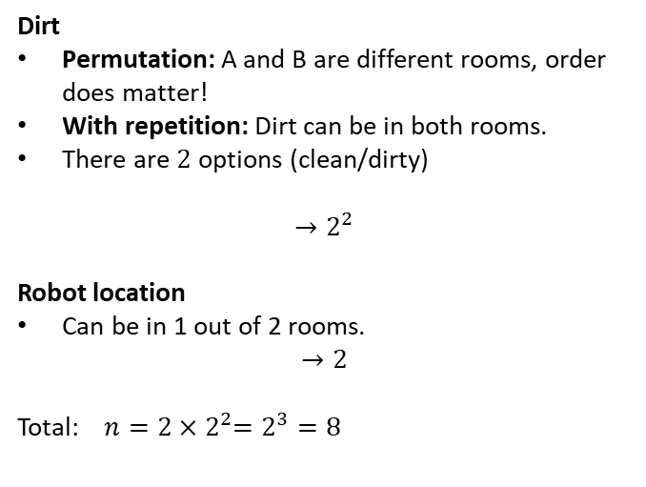
Example: What is the State Space Size?
Dirt
Permutation: A and B are different rooms, order does matter!
With repetition: Dirt can be in both rooms.
There are $2$ options (clean/dirty)
$${→2}^{2}$$
Robot location
Can be in 1 out of 2 rooms.
$$→2$$
Total: $n=2{×2}^{2}=2^{3}=8$
r … # of rooms n … options

Slide 28
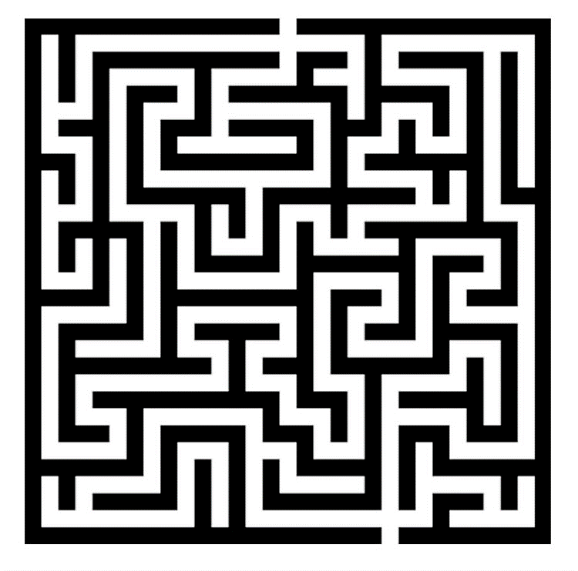
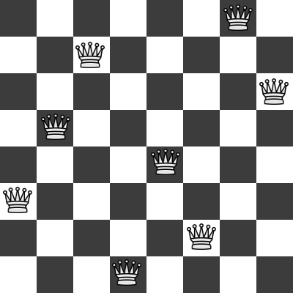
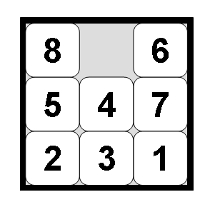

Examples: What is the State Space Size?
Often a rough upper limit is sufficient to determine how hard the search problem is.
Maze
8-queens problem
8-puzzle problem
Tic-tac-toe

Slide 29
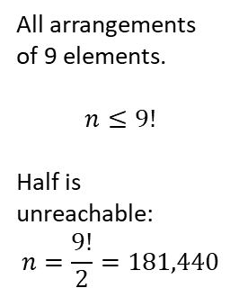
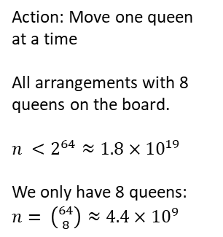
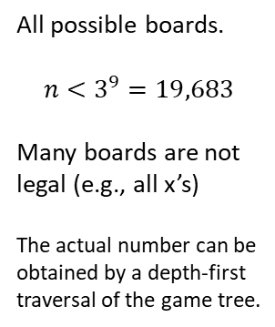
Examples: What is the State Space Size?
Often a rough upper limit is sufficient to determine how hard the search problem is.
Maze
8-queens problem
8-puzzle problem
Tic-tac-toe
Positions the agent can be in.
n = Number of white squares.
Action: Move one queen at a time
All arrangements with 8 queens on the board.
$n <2^{64}≈1.8×{10}^{19}$
We only have 8 queens: $n= \left({64 \atop 8}\right)≈4.4×{10}^{9}$
All arrangements of 9 elements.
$$n≤9!$$
Half is unreachable: $$n=\frac{9!}{2}=181,440$$
All possible boards.
$$n<3^{9}=19,683$$
Many boards are not legal (e.g., all x’s)
The actual number can be obtained by a depth-first traversal of the game tree.

Slide 30
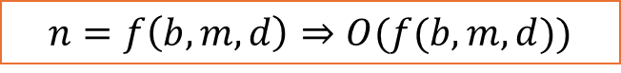
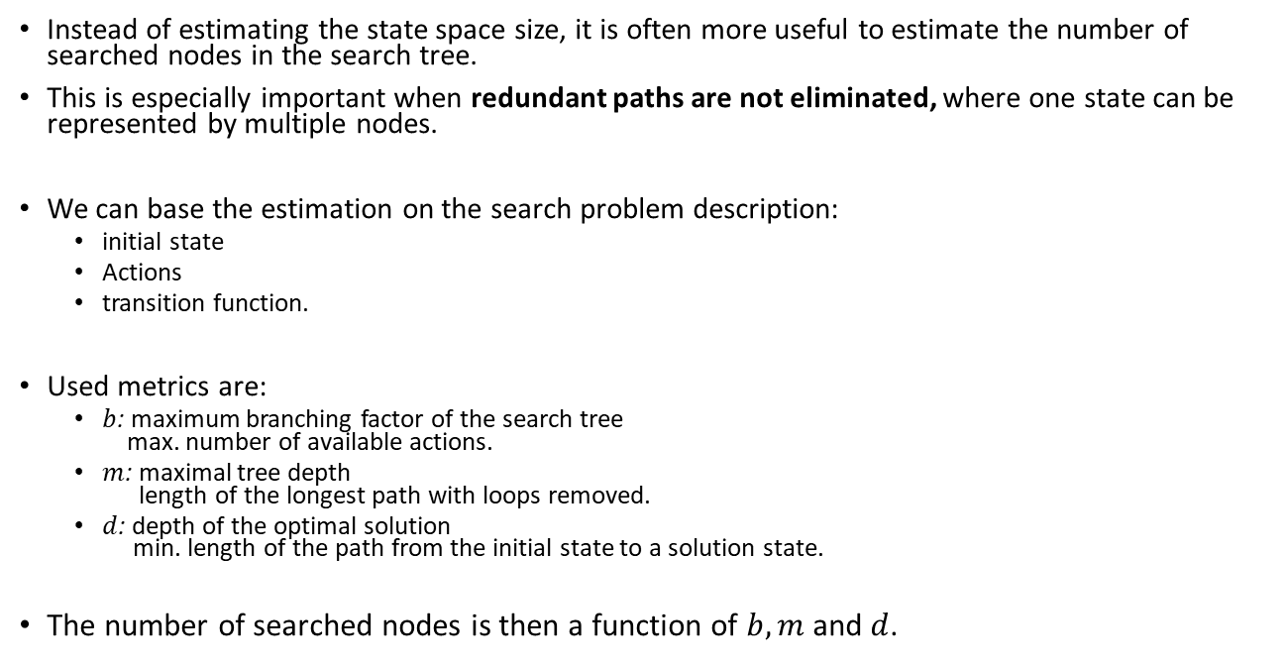
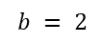
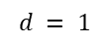
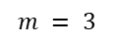
Estimating the Search Tree Size
Instead of estimating the state space size, it is often more useful to estimate the number of searched nodes in the search tree.
This is especially important when redundant paths are not eliminated, where one state can be represented by multiple nodes.
We can base the estimation on the search problem description:
initial state
Actions
transition function.
Used metrics are:
$b$: maximum branching factor of the search tree max. number of available actions.
$m$: maximal tree depth length of the longest path with loops removed.
$d$: depth of the optimal solution min. length of the path from the initial state to a solution state.
The number of searched nodes is then a function of $b, m$and $d$.
A
$$b = 2$$
$$d = 1$$
B
Goal
$$m = 3$$
C
D
E
F
G
E
C
Goal
$$n=f\left(b,m,d\right)⇒O(f(b,m,d))$$

Slide 31
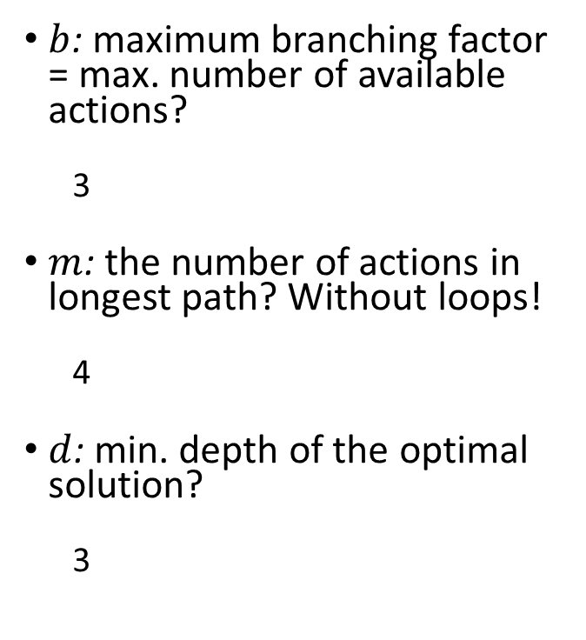
Example: What is the Search Complexity?
$b$: maximum branching factor = max. number of available actions?
3
$m$: the number of actions in longest path? Without loops!
4
$d$: min. depth of the optimal solution?
3
State Space with Transition Model
Initial state
Goal states
Make sure it is a tree!

Slide 32
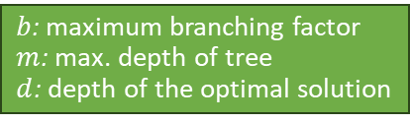
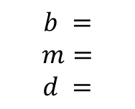
Examples: What is the Search Complexity?
$b$: maximum branching factor
$m$: max. depth of tree
$d$: depth of the optimal solution
Often a rough upper limit is sufficient to determine how hard the search problem is.
Maze
8-queens problem
8-puzzle problem
Tic-tac-toe
$$b =$$
$$m=$$
$$d =$$

Slide 33
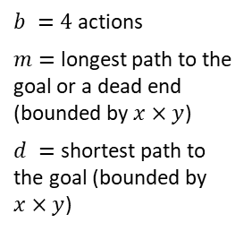
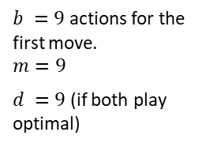
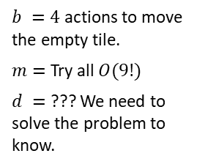
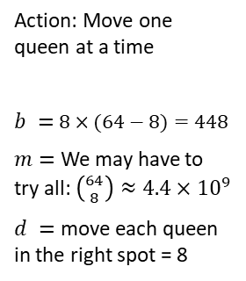
Examples: What is the Search Complexity?
$b$: maximum branching factor
$m$: max. depth of tree
$d$: depth of the optimal solution
Often a rough upper limit is sufficient to determine how hard the search problem is.
Maze
8-queens problem
8-puzzle problem
Tic-tac-toe
$b =4$ actions
$m=$ longest path to the goal or a dead end (bounded by $x×y$)
$d =$ shortest path to the goal (bounded by $x×y$)
Action: Move one queen at a time
$b =$ $8×(64−8)=448$
$m=$ We may have to try all: $\left({64 \atop 8}\right)≈4.4×{10}^{9}$
$d =$ move each queen in the right spot = 8
$b =4$ actions to move the empty tile.
$m=$ Try all $O(9!)$
$d =$ ??? We need to solve the problem to know.
$b =9$ actions for the first move.
$$m=9$$
$d =9$ (if both play optimal)

Slide 34

Uninformed Search
Breadth-First Search

Slide 35
Uninformed Search Strategies
The search algorithm/planning agent is not provided with information about how close a state is to the goal state.
It only uses the labels of the atomic states and the transition function.
It blindly searches, following a simple strategy, until it reaches the goal state.
Search strategies:
Breadth-first search strategy: BFS and uniform-cost search
Depth-first search strategy: DFS and Iterative deepening search

Slide 36
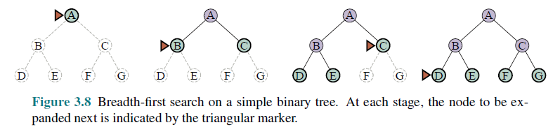
Breadth-First Search (BFS)
Expansion rule: Expand shallowest unexpanded node in the frontier (=FIFO).
Data Structures
Frontier data structure: holds references to the green nodes (green) and is implemented as a FIFO queue.
Reached data structure: holds references to all visited nodes (gray and green) and is used to prevent visiting nodes more than once (cycle and redundant path checking).
Builds a complete tree with links between parent and child.

Slide 37
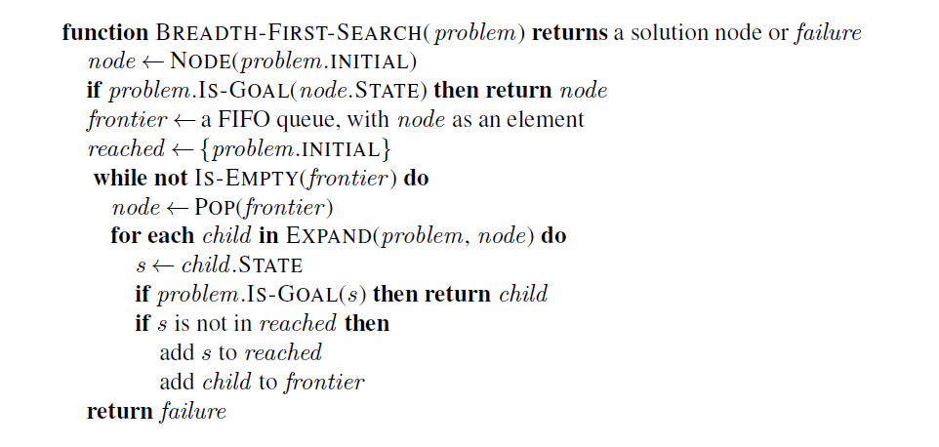
Implementation: Breadth-First Search
Expand adds the next level below node to the frontier.
reached makes sure we do not visit nodes twice (e.g., in a cycle or other redundant path). Fast lookup is important.

Slide 38
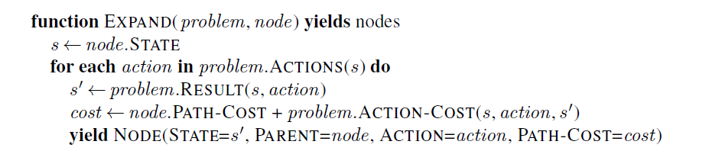
Implementation: Expanding the Search Tree
AI tree search creates the search tree while searching.
The EXPAND function tries all available actions in the current node using the transition function (RESULTS).
It returns a list of child nodes for the frontier.
Transition function
Yield (generator function) can also be implemented by returning a list of nodes.

Slide 39
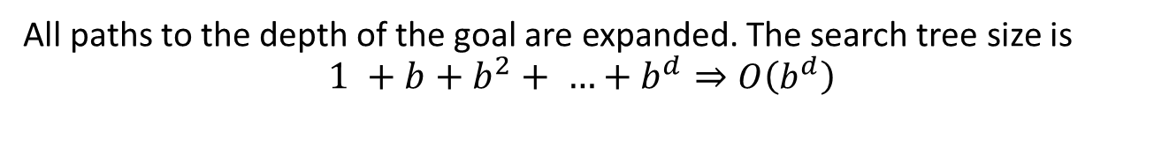
Time and Space Complexity Breadth-First Search
d: depth of the optimal solution
m: max. depth of tree
b: maximum branching factor
A
expanded
b = 2
d = 1
m = 3
Goal
B
C
D
E
F
G
E
C
Goal
All paths to the depth of the goal are expanded. The search tree size is
$$1 +b+b^{2}+ …+b^{d}⇒O\left(b^{d}\right)$$

Slide 40

Properties of Breadth-First Search
d: depth of the optimal solution
m: max. depth of tree
b: maximum branching factor
Complete?
Yes
Optimal?
Yes – if cost is the same per step (action). Otherwise: Use uniform-cost search.
Time?
Number of nodes created: $O(b^{d})$
Space?
Stored nodes: $O(b^{d})$
Note:
In AI, the large space complexity is usually a bigger problem than time!

Slide 41

Uniform-cost Search (= Dijkstra’s Shortest Path Algorithm)
Expansion rule: Expand node in the frontier with the least path cost from the initial state.
Implementation: best-first search where the frontier is a priority queue ordered by lower $f(n)$ = path cost (cost of all actions starting from the initial state).
Breadth-first search is a special case when all step costs being equal, i.e., each action costs the same!
Complete?
Yes, if all step cost is greater than some small positive constant ε > 0
Optimal?
Yes – nodes expanded in increasing order of path cost
Time?
Expands all nodes with path cost $c≤C^{∗}$ (cost of optimal solution) leading to O(b^{1+C*/ ε}) for the number of nodes.
Note: This can be greater than BFS’s O(b^{d}): the search can explore long paths consisting of small steps before exploring shorter paths consisting of larger steps.
Space?
O(b^{1+C*/ ε})
See Dijkstra's algorithm on Wikipedia
d: depth of the optimal solution
m: max. depth of tree
b: maximum branching factor

Slide 42


Implementation: Best-First Search Strategy
Note: This generalizes Breadth-First-Search
The order for expanding the frontier is determined by f(n) = path cost from the initial state to node n.
This check is added to BFS! It visits a node again if it can be reached by a better (cheaper) path.
See BFS for function EXPAND.

Slide 43
Uninformed Search
Depth-First Search

Slide 44

Depth-First Search (DFS)
Expansion rule: Expand deepest unexpanded node in the frontier (last added).
Frontier: stack (LIFO)
No reached data structure! Cycle checking checks only the current path. Redundant paths can not be identified and lead to replicated work.

Slide 45



Implementation: DFS
DFS could be implemented like BFS/Best-first search, just taking the last element from the frontier (LIFO). However, to reduce the space complexity to $O(bm)$, no reached data structure can be used!
Options:
Iterative implementation: Build the tree, and abandoned branches are removed from memory. Cycle checking is only done against the current path. This is similar to Backtracking search.
Recursive implementation: Cycle checking is an issue because the current path is stored in the function call stack, which is not accessible to the function. An additional data structure that contains the nodes in the current path can be used.
DFS uses ℓ $=∞$
Memory management: remove nodes for abandoned branches here!
Cycles: Prevent cycles by checking against the current path. We also need to ensure that the frontier does not contain the same state more than once.
Redundant paths: We cannot prevent other redundant paths.
See BFS for function EXPAND.

Slide 46

Time and Space Complexity Depth-First Search
d: depth of the optimal solution
m: max. depth of tree
b: maximum branching factor
A
A
b = 2
d = 1
C
B
Goal
C
B
m = 3
E
D
E
D
H
H
I
I
Goal
DFS finds this goal first ⬄ Not optimal!
Time:$O\left(bm\right)$ – worst case is expanding all paths.
Space: $O(bm)$ - if it only stores the frontier nodes and the current path.

Slide 47

Properties of Depth-First Search
Complete?
In finite search spaces, cycles are avoided by checking for repeated states along the path.
Incomplete in infinite search spaces (e.g., with cycles).
Optimal?
No – returns the first solution it finds.
Time?
The worst case is to reach a solution at maximum depth m in the last path: $O\left(bm\right)$ Terrible compared to BFS if $m≫d.$
Space?
$O\left(bm\right)$ is linear in max. tree depth $m$ which is very good but only achieved if no reached data structure and memory management is used!
Cycles can be broken but redundant paths cannot be checked.
d: depth of the optimal solution
m: max. depth of tree
b: maximum branching factor

Slide 48
Iterative Deepening Search (IDS)
Can we
get DFS’s good memory footprint,
avoid infinite cycles, and
preserve BFS’s optimality guaranty?
Use depth-restricted DFS and gradually increase the depth.
Check if the root node is the goal.
Do a DFS searching for a path of length 1
If goal not found, do a DFS searching for a path of length 2
If goal not found, do a DFS searching for a path of length 3
…

Slide 49

Iterative Deepening Search (IDS)

Slide 50

Implementation: IDS
See BFS for function EXPAND.

Slide 51

Properties of Iterative Deepening Search
Complete?
Yes
Optimal?
Yes, if step cost = 1 (like BFS)
Time?
Consists of rebuilding trees up to $d$ times
$db + (d−1)b2 + … + {1b}^{d} = O(b^{d})$⬄ Slower than BFS, but the same complexity class!
Space?
O(bd) ⬄ linear space. Even less than DFS since $m≤d$. Cycles need to be handled by the depth-limited DFS implementation.
Note: IDS produces the same result as BFS but trades much better space complexity for worse run time.
d: depth of the optimal solution
m: max. depth of tree
b: maximum branching factor
This makes IDS/DFS the workhorse of AI.

Slide 52

Informed Search Introduction

Slide 53

Informed Search
AI search problems typically have a very large search space. We would like to improve efficiency by expanding as few nodes as possible.
The agent can use additional information in the form of “hints” about what promising states are to explore first. These hints are derived from
information the agent has (e.g., a map with the goal location marked) or
percepts coming from a sensor (e.g., a GPS sensor and coordinates of the goal).
The agent uses a heuristic function $h(n)$ to rank nodes in the frontier and always select the most promising node in the frontier for expansion using the best-first search strategy.
Discussed algorithms:
Greedy best-first search
A* search

Slide 54

Heuristic Function
Heuristic function $h(n)$estimates the cost of reaching a node representing the goal state from the current node $n$.
Examples:
Euclidean distance
Manhattan distance
Start state
Start state
Goal state
Goal state

Slide 55

Heuristic for the Romania Problem
Estimate the driving distance from Arad to Bucharest using a straight-line distance.
h(n)
366

Slide 56

Greedy Best-First Search Example
Expansion rule: Expand the node that has the lowest value of the heuristic function h(n)
h(n)=

Slide 57

Greedy Best-First Search Example

Slide 58

Greedy Best-First Search Example

Slide 59

Greedy Best-First Search Example
Total:
140 + 99 + 211 = 450 miles

Slide 60
Properties of Greedy Best-First Search
Complete?
Yes – Best-first search if complete in finite spaces.
Optimal?
No
Total:
140 + 99 + 211 = 450 miles
Alternative through Rimnicu Vilcea:
140 + 80 + 97 + 101 = 418 miles

Slide 61
Implementation of Greedy Best-First search
Best-First Search
Expand the frontier using $$f\left(n\right)=h(n)$$
Expand the frontier using 𝑓(𝑛)=ℎ(𝑛)

Slide 62
Implementation of Greedy Best-First Search
Heuristic $h(n)$ so we expand the node with the lowest estimated cost
The order for expanding the frontier is determined by f(n)
See BFS for function EXPAND.

Slide 63

Properties of Greedy Best-First Search
Complete?
Yes – Best-first search if complete in finite spaces.
Optimal?
No
Time?
Worst case: O(b^{m}) ⬄ like DFS
Best case: O(bm) – If $h(n)$ is 100% accurate we only expand a single path.
Space?
Same as time complexity.
d: depth of the optimal solution
m: max. depth of tree
b: maximum branching factor

Slide 64
Informed Search A* Search

Slide 65


The Optimality Problem of Greedy Best-First search
Greedy best-first search only considers the estimated cost to the goal.
$h=1$ is better than $h=2$. Greedy best-first will go this way and never reconsider!

Slide 66




A* Search
$f\left(n′\right)=3$
n’
$g(n)$ = 3
$f\left(n\right)=4$
n
Idea: Take the cost of the path to $n$ called $g(n)$ into account to avoid expanding paths that are already very expensive.
The evaluation function $f(n)$ is the estimated total cost of the path through node $n$ to the goal:
$$f(n) = g(n) + h(n)$$
$g(n)$: cost so far to reach n (path cost)
$h(n)$: estimated cost from n to goal (heuristic)
The agent in the example above will stop at n with $f\left(n\right)=3+1=4$and chose the path up with a better $f\left(n’\right)=1+2=3.$
Note: For greedy best-first search we just used $f(n) = h(n).$
Notes:
Dates back to 1968

Slide 67



A* Search Example
Expansion rule: Expand the node with the smallest f(n)
$$f\left(n\right)=g(n)+h(n)=$$
$$h(n)$$

Slide 68


A* Search Example
$$f\left(n\right)=g\left(n\right)+h(n)$$
$$h(n)$$

Slide 69

A* Search Example
$$f\left(n\right)=g\left(n\right)+h(n)$$
$$h(n)$$

Slide 70

A* Search Example
$$f\left(n\right)=g\left(n\right)+h(n)$$
$$h(n)$$
Reconsiders Rimnicu Vilcea because Fagaras may have a shorter total cost to Bucharest.

Slide 71

A* Search Example
$$f\left(n\right)=g\left(n\right)+h(n)$$
$$h(n)$$

Slide 72

A* Search Example
$$f\left(n\right)=g\left(n\right)+h(n)$$
$$h(n)$$

Slide 73



BFS vs. A* Search
BFS
A*
A*
Source: Wikipedia
A* Search expands fewer nodes than BFS!

Slide 74


Implementation of A* Search
Path cost to $n$ + heuristic from $n$ to goal = estimate of the total cost $$g\left(n\right)+h(n)$$
The order for expanding the frontier is determined by $f(n)$
See BFS for function EXPAND.

Slide 75

Optimality: Admissible Heuristics
Definition: A heuristic $h$ is admissible if for every node $n$, $h\left(n\right)≤ h^{∗}(n)$, where $h^{∗}(n)$ is the true cost to reach the goal state from $n$.
I.e., an admissible heuristic is a lower bound and never overestimates the true cost to reach the goal.
Example: Straight line distance never overestimates the actual road distance.
Theorem: If $h$ is admissible, A* is optimal.

Slide 76







Proof of Optimality of A* Search
$$f(n) = g(n) + h(n)$$
For goal states:
$$f(n^{∗}) = g(n) +0$$
n* (goal)
Any unexplored node $n$ has:
$$C^{∗}=f(n^{∗}) = g(n^{∗}) + 0$$
n
$$f\left(n\right)≥ f(n^{∗})$$
n’ (other goal)
$$g\left(n^{′}\right)≥ f\left(n\right)⟺g\left(n^{′}\right)≥ C^{∗}$$
Suppose A* terminates its search at goal $n^{∗}$ at a cost of $C^{∗}=f\left(n^{∗}\right)$.
All unexplored nodes $n$ have $f\left(n\right)≥ f(n^{∗})$or they would have been explored before $n^{∗}.$
Since $f(n)$ is an optimistic estimate, it is impossible for $n$ to have a successor goal state $n’$ with $C′< C^{∗}$.
This proofs that $n^{∗}$ must be an optimal solution.

Slide 77

Guarantees of A* Search
A* is optimally efficient
No other tree-based search algorithm that employs the same heuristic can expand fewer nodes and still guarantee the optimal solution.
Proof: Any algorithm that does not expand all nodes with $f(n) < C^{∗}$(the lowest cost of going to a goal node) cannot be optimal. It risks missing the optimal solution.

Slide 78

Properties of A*Search
Complete?
Yes
Optimal?
Yes
Time?
Number of nodes for which $f(n) ≤ C^{∗}$ in the worst case $O(b^{d})$ like BFS.
Space?
Same as time complexity. This is often too high unless a very good heuristic is know.

Slide 79

Iterative-Deepening A* Search – IDA*
Idea: A* search without a reached data structure.
Remember: Regular IDA is uninformed and increases the cutoff by one after each iteration.
IDA* uses the cost $f=g+h$ of a node as the cutoff. In each iteration, the cost cutoff increases slightly. It is optimal if steps are small and $h$ is admissible.
Issues:
By how much to increase the cutoff in each iteration.
Rebuilds the tree many times.
Other memory-bounded variants of A* search:
Recursive best-first search (RBFS) adds a $f$-limit to the depth-first search behavior of best-first search.
Simplified memory-bounded A* (SMA*) performs A* till the memory is full and then drops the worst (highest $f$) leaf node from memory. It can rebuild the node later if needed.

Slide 80
Informed Search Designing Heuristics

Slide 81

Designing Heuristic Functions
Example heuristics for the 8-puzzle:
$h1(n)$ = number of misplaced tiles
$h1(start) = 8$
$h2(n)$ = total Manhattan distance (number of squares from the desired location of each tile)
$h2(start) = 3+1+2+2+2+3+3+2 = 18$
Are $h1$ and $h2$ admissible?
1 needs to move 3 positions

Slide 82


Heuristics from Relaxed Problems
A problem with fewer restrictions on the actions is called a relaxed problem.
The cost of an optimal solution to a relaxed problem is an admissible heuristic for the original problem. I.e., the true cost is never smaller.
What relaxation is used by $h_{1}$ and $h_{2}$?
$h1$: If the rules of the 8-puzzle are relaxed so that a tile can move anywhere, then $h1(n)$gives the shortest solution.
$h2$: If the rules are relaxed so that a tile can move to any adjacent square, then $h2(n)$gives the shortest solution.
$$h1(start) = 8$$
$$h2(start)= 3+1+2+2+2+3+3+2 = 18$$

Slide 83
Heuristics from Relaxed Problems
What relaxations are used in these two cases?
Euclidean distance
Manhattan distance
Start state
Start state
Goal state
Goal state

Slide 84

Heuristics from Subproblems
Let $h3(n)$ be the cost of getting a subset of tiles (say, 1,2,3,4) into their correct positions. The final order of the * tiles does not matter.
Solutions for subproblems are an admissible heuristic.
Calculation:
Very small subproblems are often easy to solve.
We can precompute and save the exact solution cost for every or many possible subproblem instances – pattern database.
*
*
*
*
*
*
*
*

Slide 85

Dominance: What Heuristic is Better?
Definition: If $h1$ and $h2$ are both admissible heuristics and $h2(n) ≥ h1(n)$for all $n$, then $h2$ dominates $h1$
Is $h1$or $h2$ better for A* search?
A* search expands every node with $f(n) < C^{∗}$⬄ $h(n) < C^{∗} – g(n)$
$h2$ is never smaller than $h1$. A* search with $h2$ will expand less nodes and is therefore better.

Slide 86

Example: Effect of Information in Search
Typical search costs for the 8-puzzle
Solution at depth $d=12$ IDS = 3,644,035 nodes A*($h1$) = 227 nodes A*($h2$) = 73 nodes
Solution at depth $d=24$ IDS ≈ 54,000,000,000 nodes A*($h1$) = 39,135 nodes A*($h2$) = 1,641 nodes

Slide 87

Combining Heuristics
Suppose we have a collection of admissible heuristics $h1, h2, …, hm,$but none of them dominates the others.
Combining them is easy:
$$h(n) = max⁡\{h1(n), h2(n), …, hm(n)\}$$
That is, always pick for each node the heuristic that is closest to the real cost to the goal $h^{∗}(n)$.

Slide 88



Satisficing Search: Weighted A* Search
Often it is sufficient to find a “good enough” solution if it can be found very quickly or with way less computational resources. I.e., expanding fewer nodes.
We could use inadmissible heuristics in A* search (e.g., by multiplying $h(n)$ with a factor $W$) that sometimes overestimate the optimal cost to the goal slightly.
It potentially reduces the number of expanded nodes significantly.
This will break the algorithm’s optimality guaranty!
$$f\left(n\right)=g\left(n\right)+W×h(n)$$
Weighted A* search: $g\left(n\right)+W×h\left(n\right)$ $(1<W<∞)$
The presented algorithms are special cases:
A* search: $g\left(n\right)+h\left(n\right)$ $(W=1)$
Uniform cost search/BFS: $g\left(n\right)$ $(W=0)$
Greedy best-first search: $h\left(n\right)$ $\left(W=∞\right)$

Slide 89





Example of Weighted A* Search
Reduction in the number of expanded nodes
Breadth-first Search (BFS)
$f\left(n\right)=$# actions to reach n
Exact A* Search $$f\left(n\right)= g(n)+h_{Eucl}(n)$$
Weighted A* Search
$$f(n) = g(n)+5 h_{Eucl}(n)$$
Source and Animation: Wikipedia

Slide 90
Tree Search Planning Agents

Slide 91

Summary: All Search Strategies
b: maximum branching factor of the search tree
d: depth of the optimal solution
m: maximum length of any path in the state space
C*: cost of optimal solution
Algorithm | Complete? | Optimal? | Time complexity | Space complexity
BFS (Breadth-first search) | Yes | If all step costs are equal | $$O(bd)$$ | $$O(bd)$$
Uniform-cost Search | Yes | Yes | Number of nodes with $g(n) ≤ C^{∗}$
DFS | In finite spaces (cycles checking) | No | $$O(bm)$$ | $$O(bm)$$
IDS | Yes | If all step costs are equal | $$O(bd)$$ | $$O(bd)$$
Greedy best-first Search | In finite spaces (cycles checking) | No | Depends on heuristic $$\text{Best} \text{case}\text{: }O(bd)$$ Worst case: $O\left(bm\right)$
A* Search | Yes | Yes | Number of nodes with $$g(n)+h(n) ≤ C^{∗}$$
With a good heuristic

Slide 92


Implementation as Best-First Search
All discussed search strategies can be implemented using Best-first search.
Best-first search expands always the node with the minimum value of an evaluation function $f(n)$.
Important note: Do not implement DFS/IDS using Best-first search! You will get poor space complexity from BFS and the disadvantages of DFS (not optimal and worse time complexity).
Search Strategy | Evaluation function $f(n)$
BFS (Breadth-first search) | $g(n)$ (=uniform path cost)
Uniform-cost Search | $g(n)$ (=path cost)
DFS/IDS (see note below!) | $$−g(n)$$
Greedy Best-first Search | $$h(n)$$
(weighted) A* Search | $$g\left(n\right)+W×h(n)$$

Slide 93
A Planning Agent: Planning vs. Execution Phase
Planning is done by a planning function using search. The result is a plan.
The plan can be executed by a model-based agent function. The plan + a step counter are stored as the state. The agent function returns the actions from the plan step-by-step.
Planning function
Execution of the plan at step 2 returns action S
Agent
Step
Plan
…
1
S
S
S
E
…
Current step (=program counter)
2
Transition model
3
4
Step 2
…
Note: The execution agent does not use percepts or the transition function. It blindly follows the plan. Caution: This only works in an environment with deterministic transitions.

Slide 94
Complete Planning Agent to Solve a Maze
Map = Transition function + initial and goal state
Environment
Physical Maze
Physical agent
has an event loop:
Read sensors
Call agent function
Execute action in the physical environment
Repeat
Planning function
Sensors
Sensor input
Need to plan or replan
percepts
State
Plan
Agent function
next action
Follow the plan
Current step in plan
Actuators
Execute action in the physical environment
The event loop calls the agent function for the next action.
The agent function follows the plan or calls the planning function if there is no plan yet or it thinks the current plan does not work based on the percepts (replanning).

Slide 95
Conclusion
Tree search can be used for planning actions for goal-based agents in known, fully observable and deterministic environments.
Issues are:
The large search space typically does not fit into memory. We use a transition function as a compact representation of the transition model.
The search tree is built on the fly, and we have to deal with cycles, redundant paths, and memory management.
DFS/IDS is a memory efficient method used often in AI for uninformed search.
Informed search uses heuristics based on knowledge or percepts to improve search performance (i.e., A* expand fewer nodes than BFS).

